Slide 1
Estimating the Significance of Sequence Order in Protein Secondary Structure and Prediction
Jong Park, Sabine Dietmann, Andreas Heger and Liisa Holm
BIOINFORMATICS, Vol. 16, No. 11, pp 978-987, 2000

Slide 2
Introduction
A protein sequence is different from others in two major ways:
  One is the composition .
  And the other is the order of amino acid residues.

Slide 3
Methods
1152 PDB40C sequences
PDB
test data
set
Assign secondary structures
e.g. ACCBAB
HHHHEE
reserved
test data set
(reversed)
e.g. ACCBAB
BABCCA

Slide 4
Methods(Cont.)
1.Prediction with normal forward sequences
Select propensity matrix
2.Prediction with reversed sequences
3.Prediction with forward and reversed sequences
Compare accuracy

Slide 5
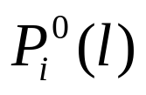
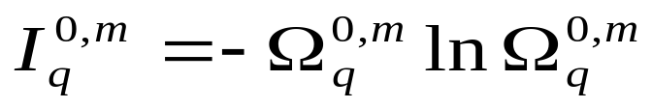
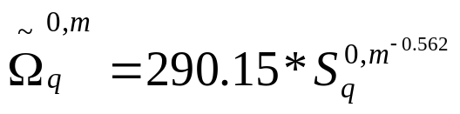
PREDATOR
Let be the secondary structure propensities of the sequence being predicted
The quality of every pairwise alignment with the base sequence is characterized by
  and (q=1~Q)

Slide 6
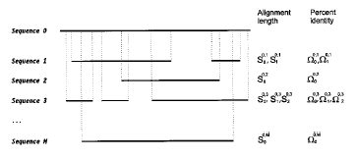
PREDATOR(Cont.)

Slide 7
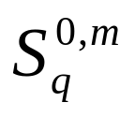

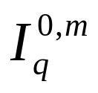
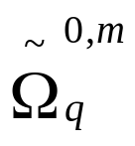
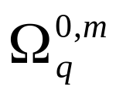
PREDATOR(Cont.)
Alignments are discarded as insignificant by applying the following selection criteria:
  < 10 (sequence length)
  < (0.1)
  <

Slide 8
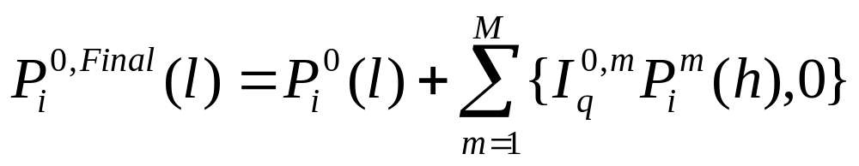
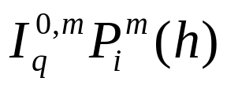
PREDATOR(Cont.)
The final values for each residue l of the base sequence are calculated as:
0 otherwise
if a residue H of sequence m is projected onto residue l of sequence 0 through local alignment q

Slide 9
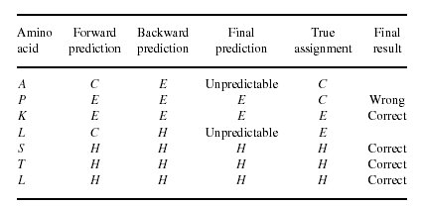
Methods(Cont.)

Slide 10
Methods(Cont.)
Ambiguous condition
For example, if the forward sequence prediction of a residue was H while the backward sequence was E;
  according to the higher reliability indices of the prediction
  set it to C
  Set it to be unpredictable

Slide 11
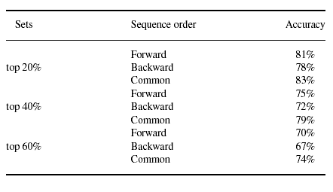
Result

Slide 12
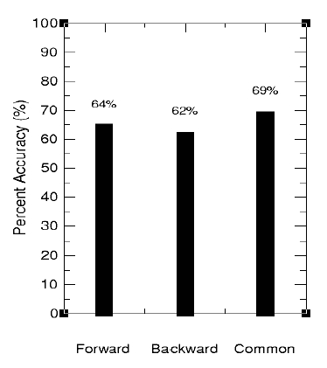
Result(Cont.)
Among the 69% accuracy:
8% for beta sheet,
22% for alpha helix,
38% for the coil

Slide 13
Conclusion
On average:
  79% of protein sequence segments resulted in the same prediction in both normal and reverse directions, which indicated a relatively high conservation of secondary structure propensity in the reverse direction.
  The combined prediction shows a slightly higher accuracy(4%) than the normal sequence prediction

Slide 14
Reference.
Frishman,D. and Argos,P.(1996) 75% Accuracy in Protein Secondary Structure Prediction. Proteins,27,pp329-335
Frishman,D. and Argos,P.(1996) Incorporation of Long-distance Interactions into a secondary structure prediction algorithm. Protein Eng.,9,pp133-142

